Slide 1
NCEP Status Update GODEX-NWP-1 Annual Meeting
Dennis Keyser
NOAA/NWS/NCEP/EMC
May 16, 2017

Slide 2
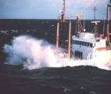
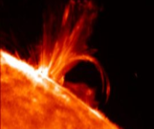
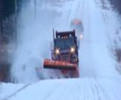
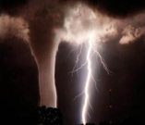
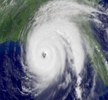
Topics
Overview of NCEP Centers, Structure, and NWP Suite
High Performance Computing
Current Data Usage
New Data Usage and Acquisition
Recent Model Upgrades
Planned Model Upgrades
Planned Data Acquisition/Use Going Forward

Slide 3
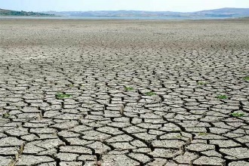
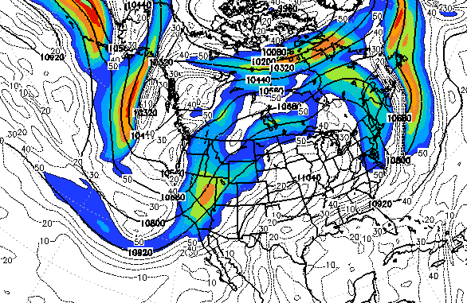
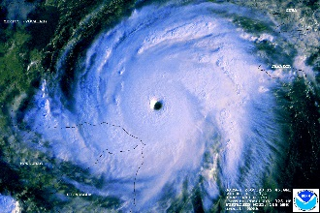
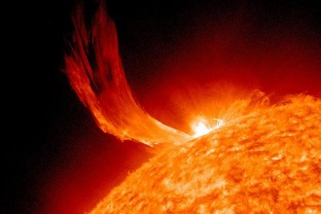
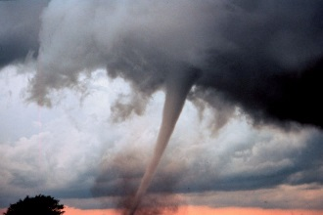
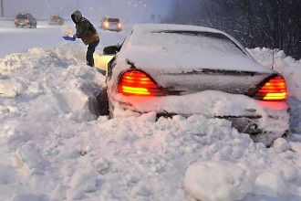
NWS National Centers for Environmental Prediction Specialized Services – Common Mission
59
48
54
48
490 FTE
237 Contractors
20 visitors
6 NOAA Corps Officers
$137M Budget
Aviation Weather Center Kansas City, MO
Climate Prediction Center
College Park, MD
Environmental
Modeling Center
College Park, MD
National Hurricane Center
Miami, FL
121
25
47
34
47
NCEP Central Operations
College Park, MD
(Supercomputers in
Reston & Orlando)
Ocean Prediction Center
College Park, MD
Space Weather
Prediction Center
Boulder, CO
Storm Prediction Center
Norman, OK
Weather Prediction Center
College Park, MD
Mission
NCEP delivers national and global operational weather, water and climate products and services essential to protecting life, property and economic well-being.
Vision
The trusted source for environmental predictions from the sun to the sea, when it matters most.
3
Notes:
9 centers
Budget cuts loom ??

Slide 4
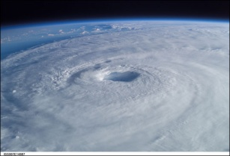
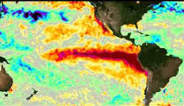
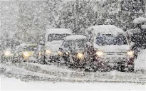
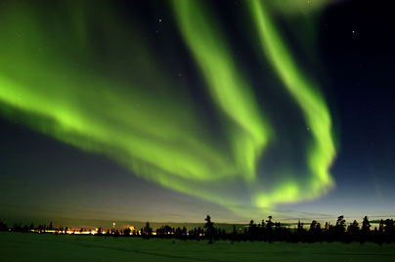
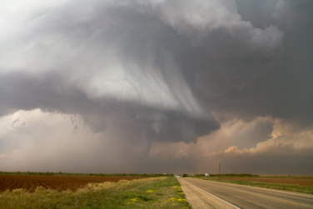
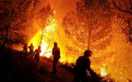
What NCEP Delivers
“Provision of Services from the Sun to the Sea”
Seasonal Outlooks (CPC)
El Nino – La Nina Forecast (CPC)
Weather Forecasts to Day 7 (WPC)
Extreme Events (Hurricanes, Severe Weather, Snowstorms, Fire Weather) (NHC, WPC, SPC)
High Seas Forecasts and Warnings (OPC)
Aviation Forecasts and Warnings (AWC)
Solar Monitoring, Warnings and Forecasts (SWPC)
Model Development, Implementation and Applications for Global and Regional Weather, Climate, Oceans and Space Weather (EMC)
Super Computer, Workstation and Network Operations (NCO)
4

Slide 5
NOAA’s Operational Numerical Guidance Suite
Climate Forecast
System (CFS)
Regional Hurricane GFDL
HWRF
Waves
WaveWatch III
Nearshore Waters
SURGE: SLOSH
ESTOFS: ADCIRC
NWPS:
WWIII
Ecosystem
EwE
3D-Var
DA
3D-En-Var
DA
GFS, MOM4, GLDAS/Noah Land, Sea Ice
^{Sea-ice}
Ocean (RTOFS)
HYCOM
Regional Bays
Great Lakes (POM)
N Gulf of Mexico (FVCOM)
Columbia R. (SELFE)
Chesapeake (ROMS)
Tampa (ROMS)
Delaware (ROMS)
Global Forecast System (GFS)
4D-En-Var
DA
NAM/NAM-nests
NMMB
Noah land model
Global Spectral
Noah Land model
3D-Hybrid-VAR DA
Global Ensemble Forecast System (GEFS)
Dispersion
HYSPLIT
Short-Range Ensemble Forecast 26 members
21 GFS Members
Air Quality
WRF-ARW & NMMB
13 members each
CMAQ
North American Ensemble Forecast System
Rapid Refresh
High Res Windows
3D-VAR
DA
GEFS, Canadian Global Model
WRF-ARW & NMMB
WRF ARW
North American Land Surface Data Assimilation System
Regional Climate Data Assimil. Syst.
National Water Model
NEMS Aerosol Global Component (NGAC)
Space
Weather
High-Res RR (HRRR)
3D-VAR
DA
WRF ARW
Noah Land Surface Model
Eta-32/NARR
Noah-MP
GFS & GOCART
ENLIL
August 2016
Notes:
5
23 boxes
25 models, different nesting ensembles
Global, regional, mesoscale, climate, AQ/dispersion, land surface, wave, hurricane, water, space weather

Slide 6
NCEP Computing Update
High Performance Computing
GODEX-NWP-1 – NCEP Update – May 2017

Slide 7
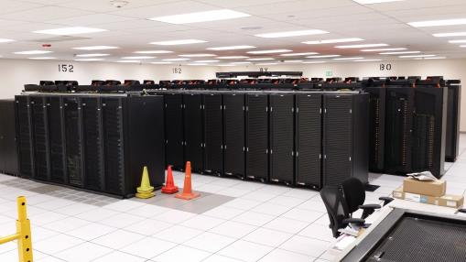
Weather & Climate Supercomputing System (WCOSS)
Location
Primary
Reston, VA (IBM provided facility) – Tide, Luna
Backup
Orlando, FL (IBM provided facility) – Gyre, Surge
Configuration
Identical Systems (per site)
IBM iDataPlex/Nextscale (Tide/Gyre)
CRAY XC-40 (Luna/Surge)
2,785 trillion calculations/sec
86,016 processing cores
(Sandybridge/Ivorybridge/Haswell)
8.48 petabytes of storage
Performance Requirements
Minimum 99.9% Operational Use Time
Minimum 99.0% On-time Product Generation
Minimum 99.0% Development Use Time
Minimum 99.0% System Availability
Failover tested regularly
Inputs and Outputs
Processes 3.5 billion observations/day
Produces over 15 million products/day
Significance
Where United States weather forecast process starts for the protection of lives and livelihood
Produces model guidance at global, national, and regional scales
Examples:
Hurricane Forecasts
Aviation / Transportation
Air Quality
Fire Weather
GODEX-NWP-1 – NCEP Update – May 2017
Notes:
7

Slide 8
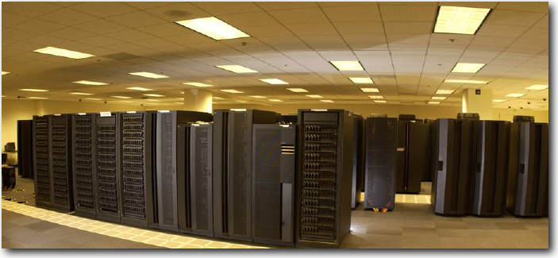
NOAA Research & Development Supercomputing
System | Location | Owner | Vendor | Capability (number and clock speed of cores) | %Avail NCEP
GAEA | Oak Ridge, TN | NOAA OCIO | CRAY | 127,168 Cores/ 1.1 PF AMD/Linux | 6.2%
THEIA | Fairmont, WV | NOAA OCIO | CRAY | 26,112 Cores/ 1.076 PF Intel Haswell 2.6 GHz Linux | 44.8%
S4 | Madison, WI | U of Wi | DELL | 3,072 Cores AMD Opteron 2.2 GHz; 1600 Cores Intel Sandy Bridge 2.9 GHz Linux | No Set Limit
DISCOVER | Greenbelt, MD (GSFC) | NASA (JCSDA; replaces JIBB | IBM/SGI | 90,336 Total Cores/3.5 PF 45 PB Storage iDataPlex/C2112 Intel Xeon Sandy Bridge/ Haswell | No Set Limit
Jet | Boulder, CO | NOAA OCIO | Aspen/ Supermicro | T-Jet 10,000 cores U-Jet 16,648 cores S-Jet 23,050 cores (all 421 TF) | 82% for HFIP
GODEX-NWP-1 – NCEP Update – May 2017

Slide 9
HPC Growth
TeraFLOP per operational system
Built into the contract are capability and storage increases approximately every 3 years with no increase in funding
NOAA modeling plans rely heavily on “built-in” contractual increases
2018 WCOSS:
Phase 1 & 2 (IBM): 725 TF
Cray XC40: 2060 TF
Phase 3 (Dell X86): 1412 TF
Bridge
WCOSS
Phase 1
WCOSS
Ph. 1+2
WCOSS
Ph. 1+2
+CRAY
WCOSS
Ph. 1+2+3(Dell)
+CRAY
GODEX-NWP-1 – NCEP Update – May 2017

Slide 10
Weather & Climate Supercomputing System (WCOSS) 2017-2018 Upgrade
Location
Primary
Reston, VA (IBM provided facility)
Backup
Orlando, FL (IBM provided facility)
Configuration
Identical Systems (per site)
Dell X86
+1,212 compute nodes
1,412 trillion calculations/sec (Peak)
33,936 processing cores
(Broadwell)
5.49 petabytes of storage
The new Dell clusters are planned to operational by January 2018. They will be
fully integrated with current IBM/Cray platform.
NCEP will have a combined ~4.2 PF (peak) compute capacity at each site with
13.97 PB of disk storage.
GODEX-NWP-1 – NCEP Update – May 2017
Notes:
10

Slide 11
FY14 – FY15 NCEP Computing Activities
CURRENT data Usage
GODEX-NWP-1 – NCEP Update – May 2017

Slide 12
Conventional Data Usage
bold black: used; aqua italicized: monitored
Observation type | Global Forecast System (GFS/GDAS) | North American Mesoscale (NAM/NDAS) | Rapid Refresh (RAP) | Real-Time Mesoscale Anal. (RTMA)
Tropical cycle bogus | pstnl (storm center), uv
Rawinsonde (TAC) | pstn, Tv, q, uv, sst | pstn, Tv, q, uv, sst | pstn, Tv, q, uv
PIBAL | uv | uv | uv
Dropsonde | Tv, q, uv | Tv, q, uv | Tv, q, uv
Dropsonde splash-level | pstn, Tv, q | pstn, Tv, q | pstn, Tv, q
RECCO | Tv, q, uv | Tv, q, uv | Tv, q, uv
AIREP | Ts, uv | Ts, uv | Ts, uv
AMDAR (TAC+BUFR) | Ts, uv | Ts, uv | Ts, uv
U.S./Mexican/ADS-C MDCRS | Ts, q, uv | Ts, q, uv | Ts, q, uv
Canadian AMDAR | Ts, uv | Ts, uv | Ts, uv
TAMDAR | Ts, q, uv | Ts, q, uv | Ts, q, uv
GPS-met (ground based) | PWt (US only) | PWt (US only) | PWt (US only)
RASS | Tv | Tv | Tv
NPN wind profiler | uv | uv | uv
Multi-agency profiler |  | uv (< 400 mb) | uv
VAD winds | uv (RCM) | uv (RCM+L2 NEXRAD) | uv (RCM+L2 NEXRAD)
JMA wind profiler | uv (currently not processed)
SYNOP (TAC), METAR | pstn, Tv, q, uv, sst | pstn, Tv, q, uv, sst | pstn, Tv, q, mta_cld, uv | pstn, Tv, q, uv, sst
Ship (TAC), buoy (TAC), platforms | pstn, Tv, q, uv, sst | pstn, Tv, q, uv, sst | pstn, Tv, q, uv | pstn, Tv, q, uv, sst
Mesonet |  | pstn, Tv, q, uv | pstn, Tv, q, uv | pstn, Tv, q, uv
mta_cld - METAR cloud amount, height of cloud base,
present weather, visibility, dewpoint
pstn - station (surface) pressure PWt - total column precipitable water
q – specific humidity
sst - sea-surface temperature Ts - sensible (dry bulb) temperature Tv - virtual temperature u v - wind
GODEX-NWP-1 – NCEP Update – May 2017

Slide 13
Conventional Data Received
NCEP 00Z GDAS ANNUAL DAILY MEAN RECEIVED CONVENTIONAL OBS
TOTAL COUNT
Thousands
GODEX-NWP-1 – NCEP Update – May 2017
Notes:
MDCRS down but coming back & will incr. when near-dups are retained
AMDARs will incr. w/ South American LATAM and BUFR-feed
Everything else essentially up – drifting buoys down due to 1 Nov TAC termination of CSLA – remapping did not fully recover these

Slide 14
Non-conventional Data
Usage
bold black: used; italicized: GFS2017; aqua italicized: monitored
Instrument/product | Global Forecast System (GFS) | North American Mesoscale (NAM) | Rapid Refresh (RAP)
AMSU-A | NOAA-15/18/19(+RARS) METOP-A/B(+RARS) AQUA | NOAA-15/18/19(+RARS) METOP-A/B(+RARS) AQUA | NOAA-15/18/19(+RARS) METOP-A/B(+RARS)
MHS | NOAA-18/19 METOP-A/B | NOAA-18/19 METOP-A/B | NOAA-18/19(+RARS) METOP-A/B(+RARS)
HIRS-4 | NOAA-19 METOP-A/B | NOAA-19 METOP-A/B | NOAA-19 METOP-A/B
AIRS-281 chn, every f-o-v | AQUA | AQUA
IASI-616 chn | METOP-A/B(+DBRTN+RARS) | METOP-A/B
SSM/IS UPP radiances | DMSP F-17/F-18 | DMSP F-17/F-18
GOES sounder radiances | GOES-15 (over water) | GOES-15 (over water) | GOES-15 (over water)
SEVIRI/CSR | METEOSAT-10/METEOSAT-8 | METEOSAT-10/METEOSAT-8
ATMS | S-NPP(+DBRTN) | S-NPP
CrIS-399 chn | S-NPP(+DBRTN) | S-NPP
SAPHIR radiances | Megha-Tropiques
GOES imgr cloud products |  | GOES-13/15 (LaRC) | GOES-13/15 (LaRC)
GOES sndr cloud products |  | GOES-15 (NESDIS) | GOES-15 (NESDIS)
SBUV ozone | NOAA-19
GOME ozone | METOP-A/B
OMI ozone | AURA
MLS ozone | AURA (not currently available)
NEXRAD L2 radial wind |  | yes | yes
NEXRAD L2 reflectivity |  | yes | yes
GODEX-NWP-1 – NCEP Update – May 2017

Slide 15
Non-conventional Data
Usage (cont.)
bold black: used; aqua italicized: monitored
Instrument/product | Global Forecast System (GFS) | North American Mesoscale (NAM) | Rapid Refresh (RAP)
GPS-RO bending angle | COSMIC-1 (FM1, FM6) GRACE-B METOP-A/METOP-B (GRAS) Terra-SAR-X TanDEM-X | COSMIC-1 (FM1, FM6) GRACE-B METOP-A/METOP-B (GRAS) Terra-SAR-X TanDEM-X
AMV’s LW-IR | GOES-13/15 HIMAWARI-8 METEOSAT-10/8 AQUA/TERRA (MODIS) NOAA-15/18/19 (AVHRR) METOP-A/B (AVHRR) S-NPP (VIIRS) | GOES-13/15 HIMAWARI-8 METEOSAT-10/METEOSAT-8 AQUA/TERRA (MODIS) NOAA-15/18/19 (AVHRR) METOP-A/B (AVHRR) S-NPP (VIIRS) | GOES-13/15 HIMAWARI-8 METEOSAT-10/8 AQUA/TERRA (MODIS)
AMV’s SW-IR | GOES-13/15 | GOES-13/15
AMV’s WV-cloud top | GOES-13/15 HIMAWARI-8 METEOSAT-10/8 AQUA (MODIS) | GOES-13/15 HIMAWARI-8 METEOSAT-10/METEOSAT-8 AQUA (MODIS) | GOES-13/15 HIMAWARI-8 METEOSAT-10/8 AQUA (MODIS)
AMV’s WV-deep layer | GOES-13/15 HIMAWARI-8 METEOSAT-10/8 AQUA (MODIS) | GOES-13/15 HIMAWARI-8 METEOSAT-10/8 AQUA (MODIS) | GOES-13/15 HIMAWARI-8 METEOSAT-10/8 AQUA (MODIS)
AMV’s Visible | GOES-13/15 HIMAWARI-8 METEOSAT-10/8 | GOES-13/15 HIMAWARI-8 METEOSAT-10/METEOSAT-8 | GOES-13/15 HIMAWARI-8 METEOSAT-10/8
ASCAT scatterometer | METOP-A/METOP-B | METOP-A/METOP-B
Lightning (long & short range) |  | yes | yes
RTMA/URMA: METOP-A & -B ASCAT used; AMVs (same as NAM) used at & below 850 mb; GOES-13/15 effective cloud amount
GODEX-NWP-1 – NCEP Update – May 2017

Slide 16
Non-Conventional Data Received
NCEP 00Z GDAS ANNUAL DAILY MEAN RECEIVED NON-CONVENTIONAL OBS
TOTAL COUNT
Millions
GODEX-NWP-1 – NCEP Update – May 2017
Notes:
AIRS, IASI, CrIS biggest contributors

Slide 17
Non-Conventional Assimilated Data
NCEP 00Z GDAS ANNUAL DAILY MEAN ASSIMILATED NON-CONVENTIONAL OBS
TOTAL COUNT
Millions
YEAR
GODEX-NWP-1 – NCEP Update – May 2017
Notes:
DONE

Slide 18
NEW Data Usage and Data acquisition SINCE LAST MEETING
GODEX-NWP-1 – NCEP Update – May 2017
Notes:
DONE

Slide 19
Changes in Observational Data Usage
07 October 2015
SSM/IS UPP radiances from DMSP F-18 monitored in NAM
20 November 2015 – GOES-13 sounder failure
Radiances no longer monitored in GFS or NAM
Cloud products no longer assimilated in NAM or RAP
10 March 2016
MDCRS from Aeroméxico and ADS-C assimilated in all networks
11 May 2016 – GFS upgrade
NOAA-15/18/19, METOP-A/B AVHRR POES ir AMV’s assimilated
SNPP VIIRS POES ir AMV’s monitored
GODEX-NWP-1 – NCEP Update – May 2017
Notes:
DONE

Slide 20
Changes in Observational Data Usage (cont.)
23 August 2016 – RAP upgrade
VAD winds derived from Level 2 NEXRAD radar decoder assimilated
Surface mesonet mass and wind data assimilated
METOP-B AMSU-A and MHS radiances assimilated (includes RARS)
NEXRAD L2 radial winds assimilated
09 September 2016
METOP-A HIRS-4 radiances downgraded to monitored in all networks
17 November 2016
CLS/MeteoFrance FM-18 buoys (migrated from TAC to BUFR on 1 Nov 2016) assimilation restored in all networks
21 February 2017
METEOSAT-8 SEVIRI CSR’s monitored in GFS
GODEX-NWP-1 – NCEP Update – May 2017
Notes:
DONE

Slide 21
Changes in Observational Data Usage (cont.)
15 March 2017
HIMAWARI-8 replaced MTSAT-2 for ir, vis & wv AMV’s
21 March 2017 – NAM upgrade
Tropical cyclone bogus winds no longer assimilated
METOP-B AMSU-A and MHS radiances assimilated (AMSU-A includes RARS)
METOP-B IASI 616 channel radiances assimilated
DMSP F-17 SSM/IS UPP radiances assimilated
METEOSAT-10 SEVIRI CSR’s assimilated, METEOSAT-8 monitored
S-NPP CrIS 399 channel and ATMS radiances assimilated
METOP-B GRAS GPS-RO bending angle assimilated
HIMAWARI-8 and METEOSAT-10 wv AMV’s assimilated
NOAA-15/18/19, METOP-A/B AVHRR POES ir AMV’s assimilated
SNPP VIIRS POES ir AMV’s monitored
GOES-13/15 short-wave ir AMV’s monitored
Long and short-range lightning (Vaisala) assimilated
GODEX-NWP-1 – NCEP Update – May 2017
Notes:
DONE

Slide 22
Changes in Observational Data Usage (cont.)
31 March 2017 - METEOSAT-8 replaced METEOSAT-7
AMV usage same except in NAM where ir & vis downgraded to monitored
09 May 2017
Korean AMDAR assimilated in NAM and RAP (where in domain)
BUFR AMDAR replaces TAC (where applicable) in NAM and RAP assimilation
U.S. TAMDAR monitored in NAM and RAP
July 2017 (est.) – GFS upgrade
NCAR/NOAA Global Hawk hurricane dropsondes assimilated (all networks)
RARS and DBRTN METOP-A/B IASI 616 channel radiances assimilated
DBRTN S-NPP CrIS 399 channel and ATMS radiances assimilated
Megha-Tropiques SAPHIR radiances monitored
TanDEM-X and GRACE-B GPS-RO bending angle assimilated
SNPP VIIRS POES ir AMV’s assimilated
GODEX-NWP-1 – NCEP Update – May 2017
Notes:
DONE

Slide 23
FY16 – FY17 NCEP Computing Activities
Model Upgrades SINCE LAST MEETING
GODEX-NWP-1 – NCEP Update – May 2017
Notes:
DONE

Slide 24
Major Model Upgrades (Observations, Resolution, DA, Dynamics, Physics, Post-processing)
October-December 2015
Short-Range Ensemble Forecast (SREF)
Extra-tropical Storm Surge (ETSS) – Alaska
Global Ensemble Forecast System (GEFS)
January-March 2016
Nearshore Wave Prediction System (NWPS) (new)
Real-Time Mesoscale Analysis (RTMA)
National Blend of Models (NBM)
Community Multi-scale Air Quality (CMAQ) model
North American Ensemble Forecast System (NAEFS)
GODEX-NWP-1 – NCEP Update – May 2017
Notes:
DONE

Slide 25
Major Model Upgrades (cont.) (Observations, Resolution, DA, Dynamics, Physics, Post-processing)
April-June 2016
Global Forecast System (GFS) (4D EnVAR, land physics)
Global Current Icing Potential (GCIP) in-flight icing analysis products
Gr. Lakes Oper. Fcst System (GLOFS)/Lake Erie Oper. Fcst System (LEOFS)
Hurricane Surge On-Demand Forecast System (HSOFS)
July-September 2016
HYSPLIT (smoke and dust trajectory model)
Hurricane WRF (HWRF)/GFDL Hurricane Prediction System
National Water Model (NWM) (new)
Rapid Refresh (RAP)/High-Resolution Rapid Refresh (HRRR)
Real-Time Mesoscale Analysis (RTMA)
North American Model (NAM)
Short-Range Ensemble Forecast (SREF)
GODEX-NWP-1 – NCEP Update – May 2017
Notes:
DONE

Slide 26
Major Model Upgrades (cont.) (Observations, Resolution, DA, Dynamics, Physics, Post-processing)
October-December 2016
Real Time Global-High Res. Sea Sfc Temperature (RTG-HR SST) Analysis
Sea-Ice Concentration Analysis
Nearshore Wave Prediction System (NWPS)
Jan-May 2017
NOAA Environ. Modeling System (NEMS) GFS Aerosol Component (NGAC)
North Atlantic-Real Time Ocean Forecast System (RTOFS) (discontinued)
North American Model (NAM)
Probabilistic Hurricane Storm Surge Model (P-SURGE)
Extra Tropical Surge and Tide Operational Forecast System (ESTOFS)
Real-Time Mesoscale Analysis (RTMA)
National Water Model (NWM)
See http://www.nco.ncep.noaa.gov/pmb/changes/ for more information.
GODEX-NWP-1 – NCEP Update – May 2017
Notes:
DONE

Slide 27
FY17Q3/FY18Q1 – NCEP Computing Activities
Planned Model Upgrades
GODEX-NWP-1 – NCEP Update – May 2017
Notes:
DONE

Slide 28
Pending Model Upgrades
June 2017
Community Multi-scale Air Quality (CMAQ) model
July 2017
Global Forecast System (GFS)
Real Time Global-High Res. Sea Sfc Temperature (RTG-HR SST) Analysis
National Blend of Models
Hurricane WRF
Hurricane Non-hydrostatic Multi-scale Model on the Arakawa B grid (HNMMB)/Hurricanes in a Multi-scale Ocean-coupled Non-hydrostatic (HMON) model (replaces GFDL Hurricane Prediction System hurricane model)
Climate Forecast System (CFS)
Great Lakes Wave (GLW)
GODEX-NWP-1 – NCEP Update – May 2017
Notes:
DONE

Slide 29
Pending Model Upgrades (cont.)
September 2017
Hi-Resolution Window (HiRes)/HiResWindow Ensemble Forecast (HREF)
Real-Time Mesoscale Analysis (RTMA)
Global Wave Deterministic
Global Wave Ensemble System (GWES)/Global Wave Grids
Combined Wave Ensemble System (CWES)
Nearshore Wave Prediction System (NWPS)
North American Ensemble Forecast System (NAEFS)
Global-Real Time Ocean Forecast System (RTOFS)
October 2017
National Water Model (NWM)
November 2017
Real Time Global-High Res. Sea Sfc Temperature (RTG-HR SST) Analysis
Sea-Ice Concentration Analysis
GODEX-NWP-1 – NCEP Update – May 2017
Notes:
DONE

Slide 30
PLANNED Data acquisition/USE GOING FORWARD
GODEX-NWP-1 – NCEP Update – May 2017
Notes:
DONE

Slide 31
Future plans: Observational Data
Test existing obs data for future assimilation:
Jason-3 altimeter SSHA, wind/wave
Surface wind speed from satellite altimetry data (all sources)
HDOB (high-density hurricane aircraft reccos), SMFR peak surface wind speed
Additional U.S. mesonet data (e.g., UrbaNet, CRN, Coop)
Improved roadway data, utilize Clarus QC information
TAC to BUFR: SYNOP, Upper-air, SHIP, BUOY
TAMDAR
AMDARS from South America (LATAM airlines)
CrIS full spectrum resolution [2223 chn (2211 regular chn + 12 guard chn)]
SAPHIR radiances
SEVIRI ASR
GPM-CORE GMI radiances, precipitation retrievals
Sentinel-3A SSHA
GODEX-NWP-1 – NCEP Update – May 2017
Notes:
DONE

Slide 32
Future plans: Observational Data (cont.)
Test existing obs data for future assimilation (cont):
AMSR-2 radiances and SST
NASA aeronet sfc-based AOD
GNSS (European) + U.S. surface-based GPS ZTD
S-NPP VIIRS radiances, SST, AOD, smoke, dust, GVF
Direct readout of AIRS, AMSU-A, HIRS-4, MHS radiances and MODIS/AVHRR POES winds all from UW/CIMSS; ASCAT from RARS/EARS
GODEX-NWP-1 – NCEP Update – May 2017
Notes:
DONE

Slide 33
Future plans: Observational Data (cont.)
Acquire new obs data for testing:
U.S. wind energy providers (e.g., wind farms) – tower & nacelle
International VAD winds (e.g., Europe, New Zealand)
International wind profilers (e.g., Japan, Hong Kong, Europe, Australia, New Zealand, Samoa)
MDCRS from additional sources (e.g., ADS sources)
AMDARS from Central American and Caribbean sources
ScatSat1 OSCAT scatterometer
GPS-RO bending angle from COSMIC-2, SAC-D, KOMPSAT-5, SEOSAR/Paz
Himawari-8 CSRs/ASRs (maybe also raw AHI radiances), SST
Cryosat-2 sea ice
Sentinel-3A wind/wave, SST and ocean color data
AMSR-2 sea-ice characterization
LEO/GEO AMV’s from UW/CIMSS
GODEX-NWP-1 – NCEP Update – May 2017
Notes:
DONE

Slide 34
Future plans: Observational Data (cont.)
Acquire new obs data for testing (cont.):
Dual METOP-A/-B AMV’s
Aeolus ADM
GOES-R (AMV’s, CSR/ASR/ABI radiances, GLM lightning, AOD, dust/smoke)
JPSS-1 (Hi-resCrIS, ATMS, VIIRS) when available after launch
Surface-based GPS ZTD from other sources (e.g., Australia)
GODEX-NWP-1 – NCEP Update – May 2017
Notes:
DONE

Slide 35
Questions ???
Where America’s Climate, Weather, Ocean, and Space Prediction Services Begin”
“From the Sun to the Sea…
Where America’s Climate, Weather, Ocean and Space Weather Services Begin”
GODEX-NWP-1 – NCEP Update – May 2017
Notes:
DONE

